Slide 1
Chapter 9
UNSUPERVISED LEARNING:
Clustering
Part 1
Cios / Pedrycz / Swiniarski / Kurgan

Slide 2
Outline
What is Clustering?
- Categories of clustering methods
- Similarity measures
Partition-Based Clustering
Hierarchical Clustering
Model-Based (mixture of probabilities)
clustering
Scalable Clustering
Grid-Based Clustering
Cluster Validity
Clustering of Large Datasets
© 2007 Cios / Pedrycz / Swiniarski / Kurgan

Slide 3
What is Clustering?
How do we understand data?
We look for structure in data by revealing groups/clusters.
Clusters are about abstraction of data.
The structure is formed based on similarities between patterns (data).
© 2007 Cios / Pedrycz / Swiniarski / Kurgan

Slide 4
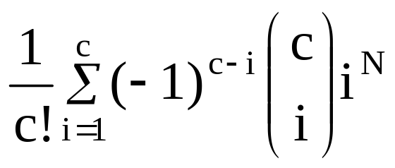

How hard is clustering?
Consider N data points to be split into “c”
groups (clusters). The number of possible splits (partitions) is described as
Even for a small problem of N =100 and c =5 we end up with 10⁶⁷ partitions
© 2007 Cios / Pedrycz / Swiniarski / Kurgan

Slide 5
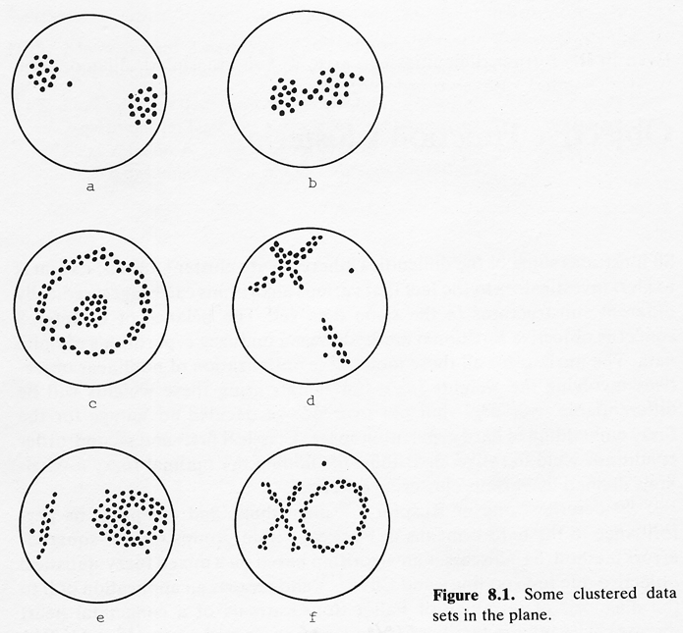
Clustering Challenges – from Bezdek
© 2007 Cios / Pedrycz / Swiniarski / Kurgan

Slide 6
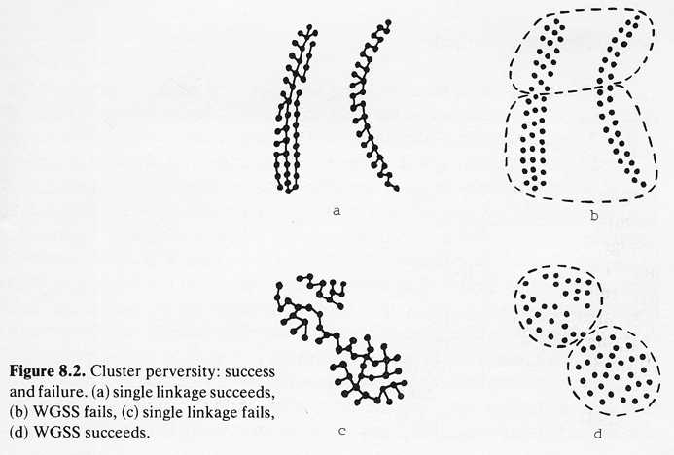
Clustering Challenges – from Bezdek
© 2007 Cios / Pedrycz / Swiniarski / Kurgan

Slide 7
Categories of Clustering
We distinguish between three main categories (classes) of clustering methods
Partition-based
Hierarchical
Model-based (mixture of probabilities)
© 2007 Cios / Pedrycz / Swiniarski / Kurgan

Slide 8
Categories of Clustering
Partitioning approach:
  Construct various partitions and then evaluate them by some criterion, e.g., minimizing the sum of square errors
  Examples: k-means, k-medoids, CLARANS
Hierarchical approach:
  Create a hierarchical decomposition of the data using some criterion
  Examples: Diana, Agnes, BIRCH, CAMELEON
Density-based approach:
  Based on connectivity and density functions
  Examples: DBSCAN, RNN-DBSCAN, OPTICS, DenClue
Grid-based approach:
  Based on a multiple-level granularity structure
  Examples: STING, WaveCluster, CLIQUE

Slide 9
Categories of Clustering
Model-based:
  A model is hypothesized for each of the clusters and its best fit is found
  Examples: EM (expectation maximization), SOM, COBWEB
Frequent pattern-based:
  Based on analysis of frequent patterns
  Example: p-Cluster
User-guided or constraint-based:
  Clustering by user-specified or application-specific constraints
  Examples: COD (obstacles), constrained clustering
Link-based clustering:
  Objects are linked together in various ways
  Examples: SimRank, LinkClus

Slide 10
Partition-Based Clustering
It is also referred to as objective function clustering, relies on the minimization of a certain objective function (performance index)
The result of the minimization is a partition matrix and a set of prototypes (centers)
© 2007 Cios / Pedrycz / Swiniarski / Kurgan

Slide 11

Partition-Based Clustering
Partitioning method: Partition data D of n objects into a set of k clusters, such that the sum of squared distances is minimized (where c_{i} is the centroid or medoid of cluster C_{i})
Given k, find a partition that optimizes the chosen (like above) partitioning criterion
  Global (optimal): is not computationally feasible - as we would have to exhaustively enumerate all possible partitions
  Heuristic: k-means and k-medoids algorithms
    k-means: Each cluster is represented by the center of the cluster
    k-medoids or PAM (Partition Around Medoids): Each cluster is represented by one of the objects in the cluster

Slide 12
Model-Based Clustering
In MBC we assume a certain probabilistic model of data and estimate its parameters, such as mean, covariance matrix, etc.
Mixture density model: we assume that data are a result of a mixture of “c” sources generating data and each source is treated as a separate cluster.
Maximum Likelihood Estimation: method for estimating parameters of a model.
© 2007 Cios / Pedrycz / Swiniarski / Kurgan

Slide 13
Similarity measures
Deciding a Similarity measure is the most fundamental component of every clustering algorithm; it is used to quantify similarity (or dissimilarity) between data points.
The data points with the highest similarity (e.g., shortest distance) are candidates for forming a cluster.
© 2007 Cios / Pedrycz / Swiniarski / Kurgan

Slide 14
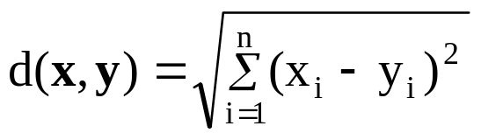
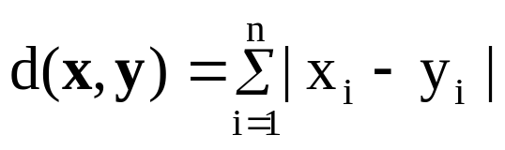
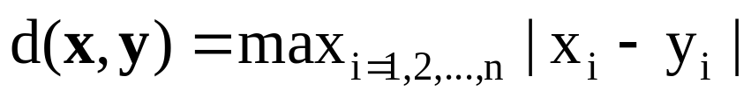
Distance Functions for Continuous Data
Euclidean distance (equivalent to p=2 in Minkowski)
Hamming distance (p=1 in Minkowski)
Tchebyschev distance (p= ∞ in Minkowski)
© 2007 Cios / Pedrycz / Swiniarski / Kurgan

Slide 15
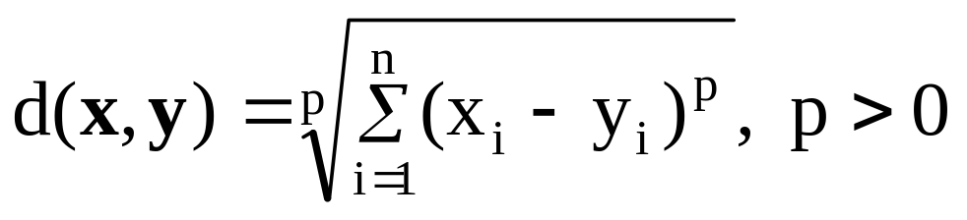
Distance Functions for Continuous Data
Minkowski distance
(from Wikipedia)
© 2007 Cios / Pedrycz / Swiniarski / Kurgan

Slide 16
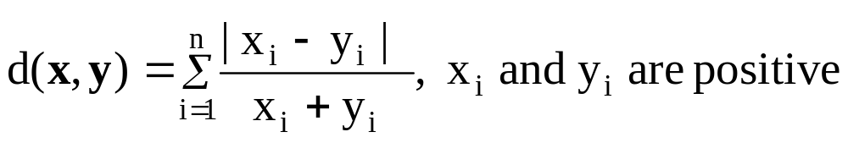
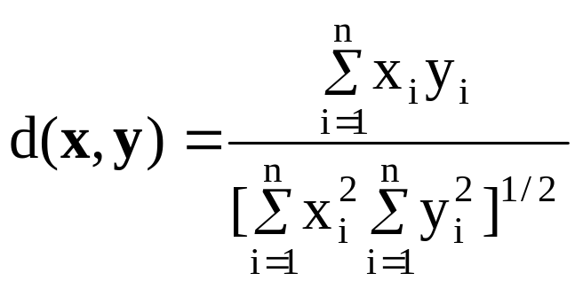
Distance Functions for Continuous Data
Canberra distance
Example:
v₁(1,1,1), v₂(1,1,0), v₃(10,5,0), v₄(1,2,3), v₅(2,4,6)
d₁₂=1 d₁₃=2.485 d₄₅=1
Angular separation
Example:
v₁(7,6,3,-1), v₂(0,3,4,5)
d₁₂=0.363
© 2007 Cios / Pedrycz / Swiniarski / Kurgan

Slide 17

Distance Functions for Discrete Data
Binary data x = [x₁ x₂ …x_{n}]
y = [y₁ y₂ …y_{n}]
a- number of occurrences where both x_{i} and y_{i} are 1
d- number of occurrences where both x_{i} and y_{i} are 0
b, c- number of occurrences where x_{i} and y_{i} are different (0-1)
© 2007 Cios / Pedrycz / Swiniarski / Kurgan

Slide 18
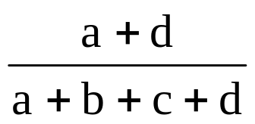
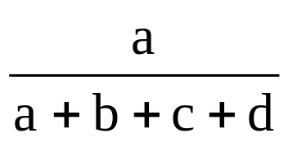
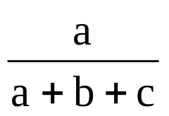
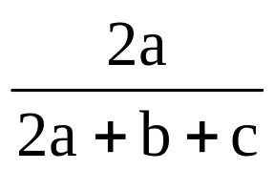
Distance Functions for Discrete Data
Matching index
Rusell & Rao
Jacard index
Czekanowski
© 2007 Cios / Pedrycz / Swiniarski / Kurgan

Slide 19
Hierarchical Clustering
HC provides graphical illustration of relationships between the data in the form of a dendrogram (binary tree).
There are two approaches to HC:
Bottom – up / agglomerative
Top-down / divisive
© 2007 Cios / Pedrycz / Swiniarski / Kurgan

Slide 20
Hierarchical Clustering
Agglomerative / bottom-up method starts with each object in the data forming its own cluster, and then successively merges the clusters until one large cluster is formed, which encompasses the entire dataset.
Divisive / top-down method starts by considering the entire data as one cluster and then splits up the cluster(s) until each object forms its own cluster.
© 2007 Cios / Pedrycz / Swiniarski / Kurgan

Slide 21
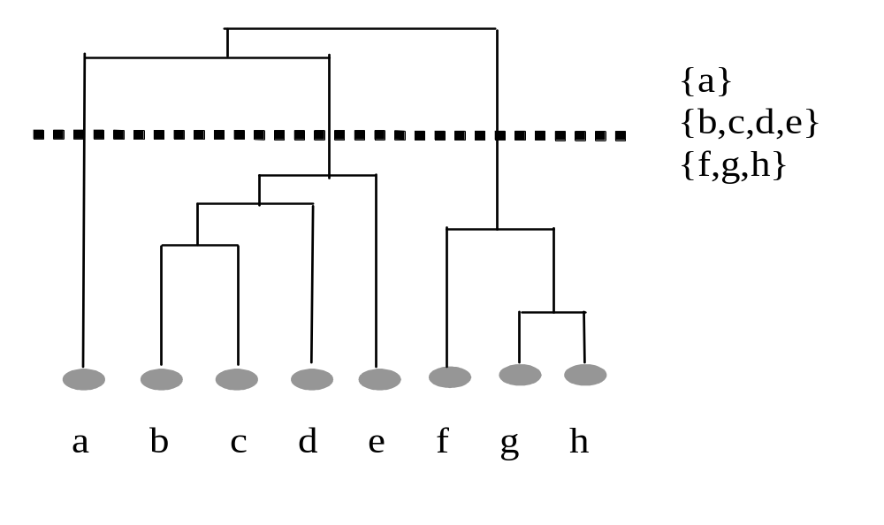
Hierarchical Clustering
Top –down /
divisive
Bottom-up /
agglomerative
© 2007 Cios / Pedrycz / Swiniarski / Kurgan

Slide 22
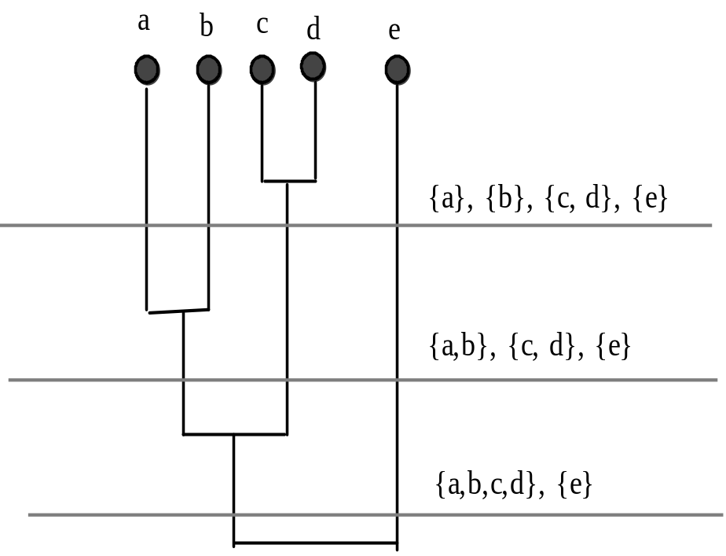
Hierarchical Agglomerative Clustering
numbers of clusters
at different levels
4
3
2
© 2007 Cios / Pedrycz / Swiniarski / Kurgan

Slide 23
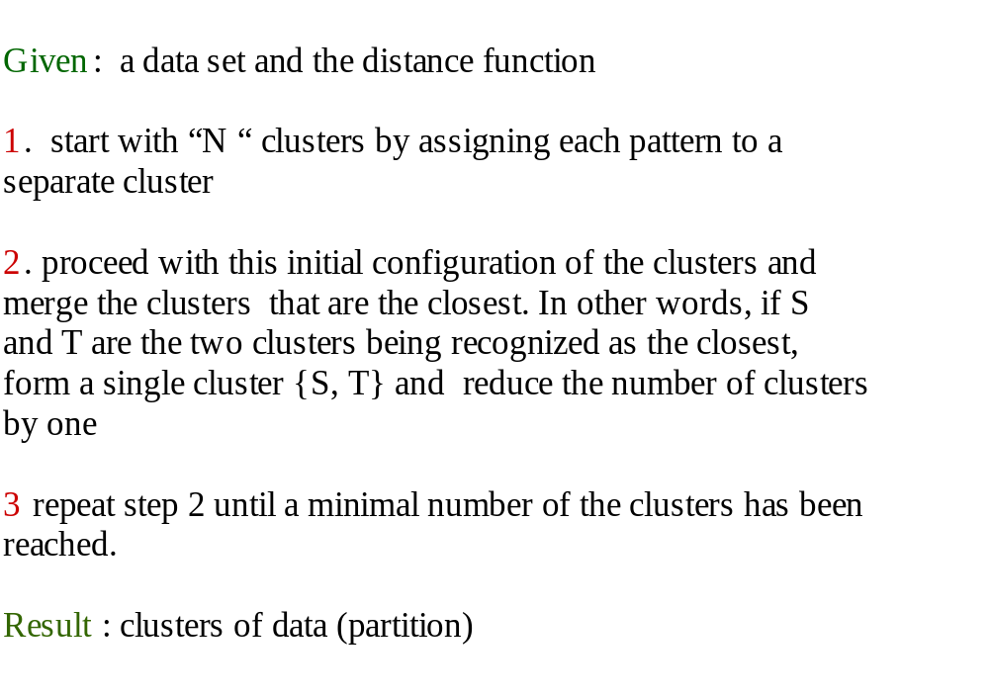
Hierarchical Agglomerative Clustering
© 2007 Cios / Pedrycz / Swiniarski / Kurgan

Slide 24
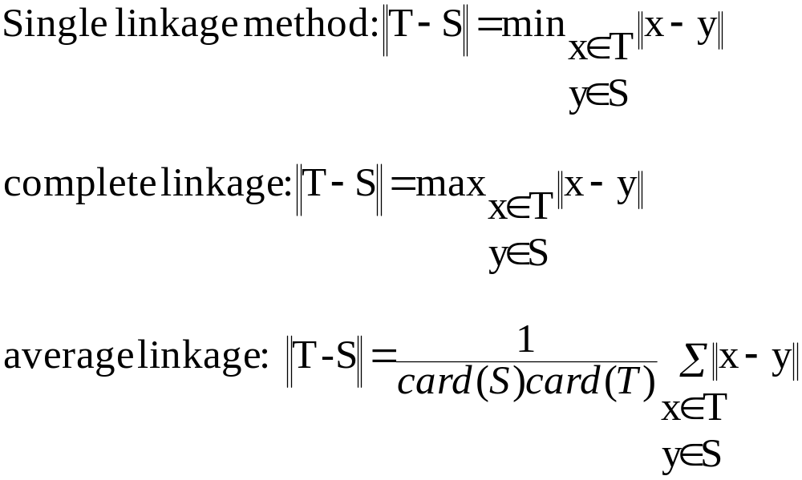
Distance Between Clusters
© 2007 Cios / Pedrycz / Swiniarski / Kurgan

Slide 25
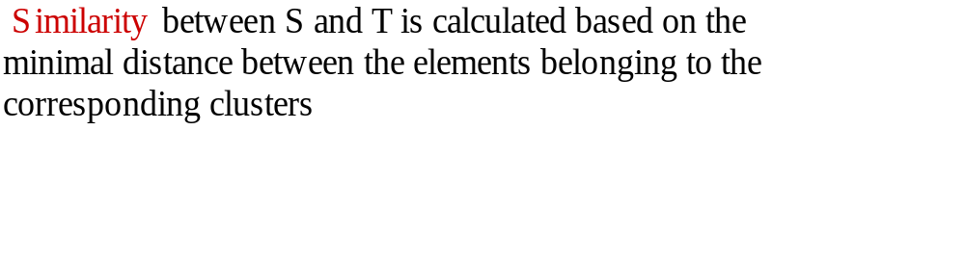
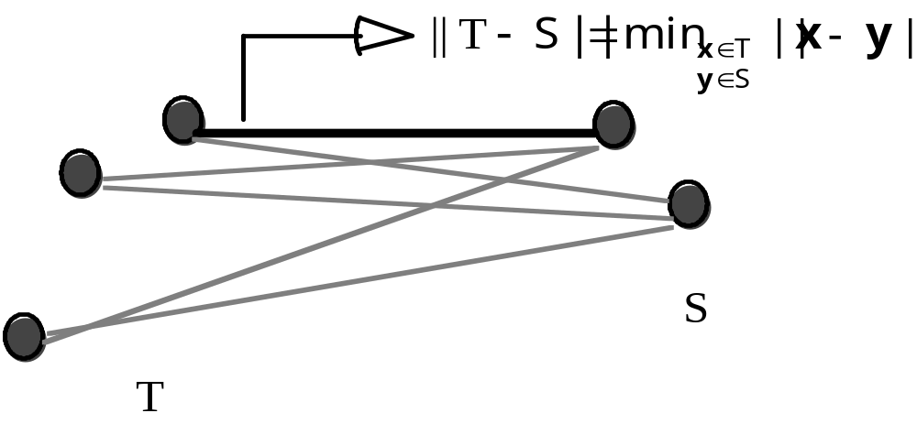
Single Linkage
© 2007 Cios / Pedrycz / Swiniarski / Kurgan

Slide 26
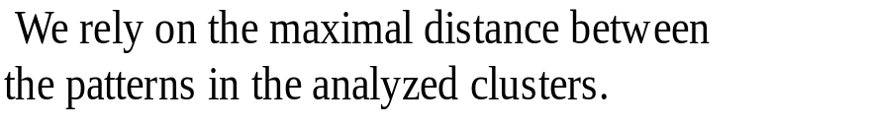
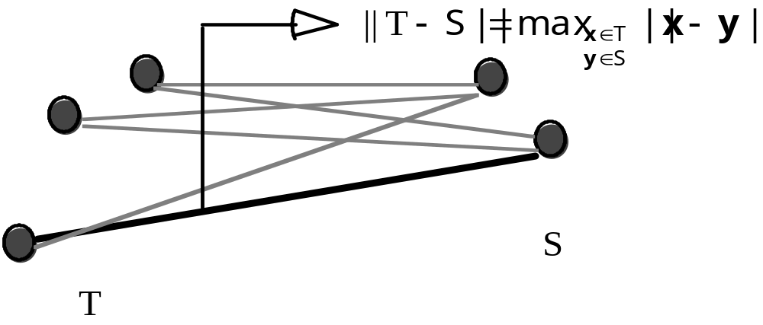
Complete Linkage
© 2007 Cios / Pedrycz / Swiniarski / Kurgan

Slide 27
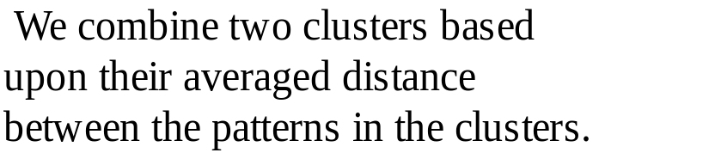
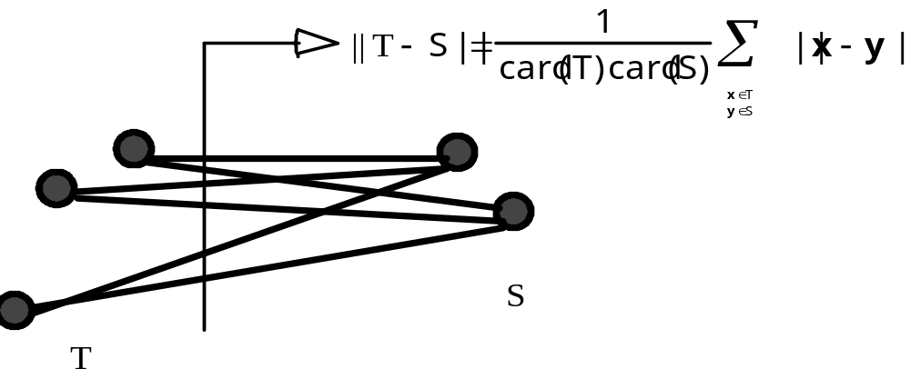
Average Linkage
© 2007 Cios / Pedrycz / Swiniarski / Kurgan

Slide 28
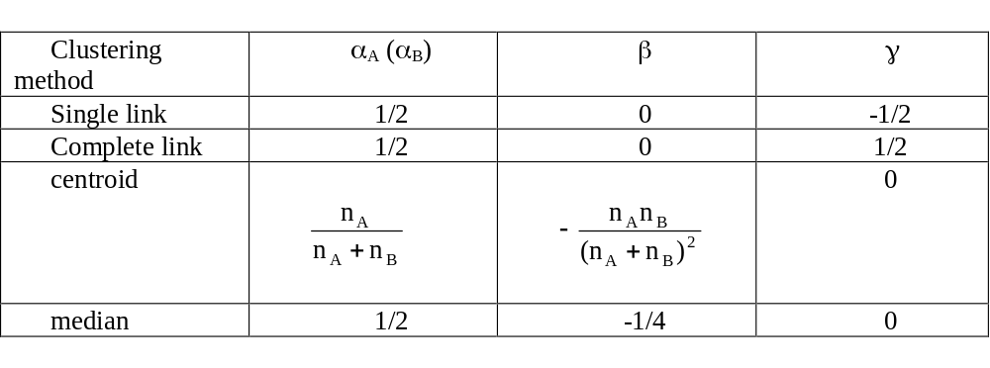
Lance-Williams formula for agglomerative clustering
Suppose that clusters A and B are to be merged. The above recursive
formula calculates the updated cluster distances following
the merge of clusters A and B. Let dAB, dAC, and dBC
be the pairwise distances between clusters A, B, and C, respectively, and
dAB,C be the distance between the new cluster AB and C.
© 2007 Cios / Pedrycz / Swiniarski / Kurgan

Slide 29
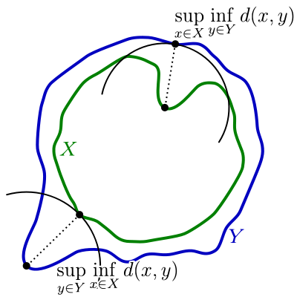
Hausdorff Distance Function
from Wikipedia
Two sets are close if every point of either set is close to some point of the other set.
It is the greatest of all the distances from a point in one set to the closest point in the other set.
d(A,B) = max { min d(A,B)} = sup { inf d(A,B)}
© 2007 Cios / Pedrycz / Swiniarski / Kurgan

Slide 30
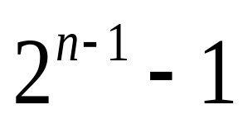
Hierarchical Divisive Method
HD algorithm starts by considering all divisions of the data into two nonempty subsets which amounts to huge # of possible divisions:
However, it is possible to construct methods that don’t consider all divisions, most of which may be incorrect anyway.
One such algorithm is by MacNaughton - Smith (1964) -> see the next slides
© 2007 Cios / Pedrycz / Swiniarski / Kurgan

Slide 31
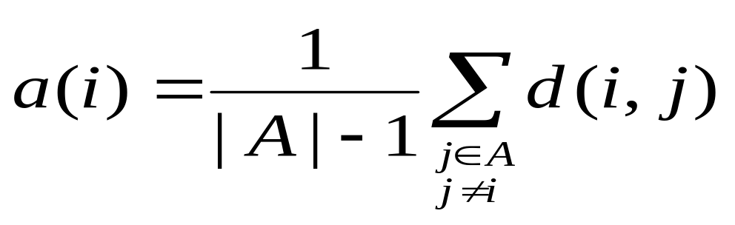
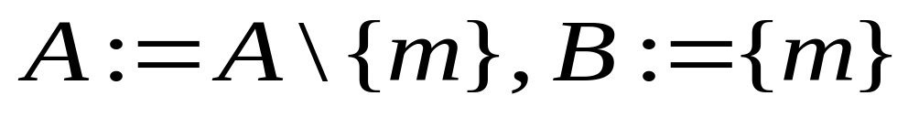
Hierarchical Divisive Method
At first A:=C and B:=∅
1. Move one object at a time from A to B.
  For each object i∈A compute average dissimilarity to all other objects of A:
  Object m of A for which a(m) is the largest, is moved to B:
© 2007 Cios / Pedrycz / Swiniarski / Kurgan

Slide 32
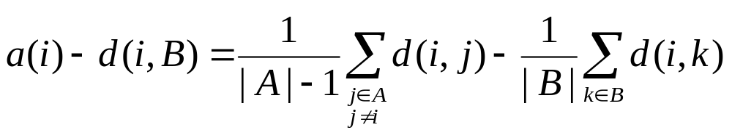
Hierarchical Divisive Method
2. Move other objects from A to B (called the “splinter group”)
  If |A|=1, stop. Otherwise compute a(i) for all i∈A, and the average dissimilarity of i to all objects of B, denoted as d(i,B)
© 2007 Cios / Pedrycz / Swiniarski / Kurgan

Slide 33
Hierarchical Divisive Method
Select object h∈A for which
If a(h)-d(h,B) > 0 ⇒ move h from A to B, go to 2
If a(h)-d(h,B) ≤ 0 ⇒ the process stops
The division of set C into clusters A and B is complete.
© 2007 Cios / Pedrycz / Swiniarski / Kurgan

Slide 34
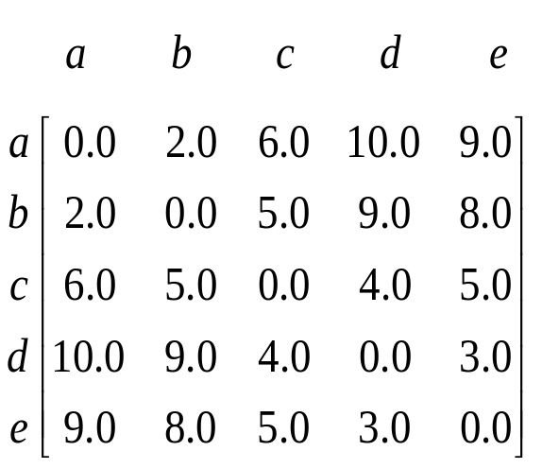
Hierarchical Divisive Method
    Object’s Average Dissimilarity to the Other Objects
    a (2.0 + 6.0 + 10.0 + 9.0)/4 = 6.75
    b (2.0 + 5.0 + 9.0 +8.0)/4 = 6.00
    c (6.0 + 5.0 + 4.0 + 5.0)/4 = 5.00
    d (10.0 + 9.0 + 4.0 + 3.0)/4 = 6.50
    e (9.0 + 8.0 + 5.0 + 3.0)/4 = 5.25
Object a is chosen to initiate the splinter group.
At this stage we have clusters A={b,c,d,e} and B={a}
© 2007 Cios / Pedrycz / Swiniarski / Kurgan

Slide 35
Hierarchical Divisive Method
Average Dissimilarity
Average Dissimilarity to Objects of
Object to remaining Objects Splinter Group Difference
b (5.0+9.0+8.0)/3≈7.33 2.00 5.33
c (5.0+4.0+5.0)/3≈4.67 6.00 -1.33
d (9.0+4.0+3.0)/3≈5.33 10.00 -4.67
e (8.0+5.0+3.0)/3≈5.33 9.00 -3.67
Therefore, object b changes sides, so new splinter group is B={a, b} and the remaining group becomes A={c, d, e}
Average Dissimilarity
Average Dissimilarity to Objects of
Object to remaining Objects Splinter Group Difference
c (4.0+5.0)/2=4.50 (6.0+5.0)/2=5.50 -1.00
d (4.0+3.0)/2=3.50 (10.0+9.0)/2=9.50 -6.00
e (5.0+3.0)/2=4.00 (9.0+8.0)/2=8.50 -4.50
© 2007 Cios / Pedrycz / Swiniarski / Kurgan

Slide 36
Partition / Objective Function Clustering
Develop and optimize a partition matrix so that a certain performance index is optimized (minimized).
Objective function
Minimization
Structure
© 2007 Cios / Pedrycz / Swiniarski / Kurgan

Slide 37
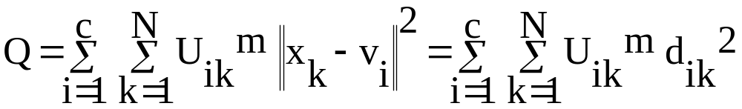
Partition / Objective Function Clustering
Depends on minimization of some performance index Q
c – number of clusters
U – partition matrix
© 2007 Cios / Pedrycz / Swiniarski / Kurgan

Slide 38
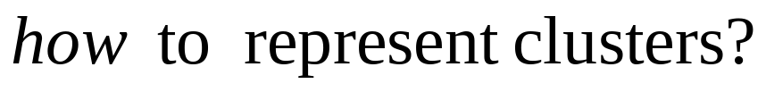
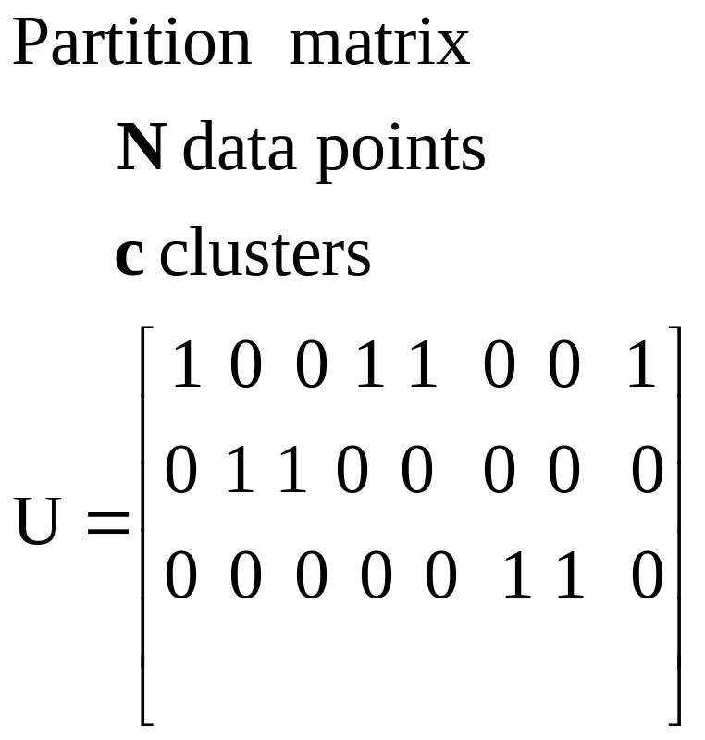
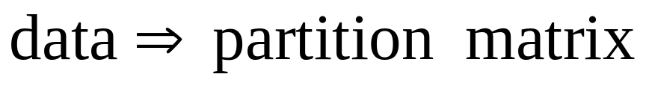
Clustering: Representation
© 2007 Cios / Pedrycz / Swiniarski / Kurgan

Slide 39
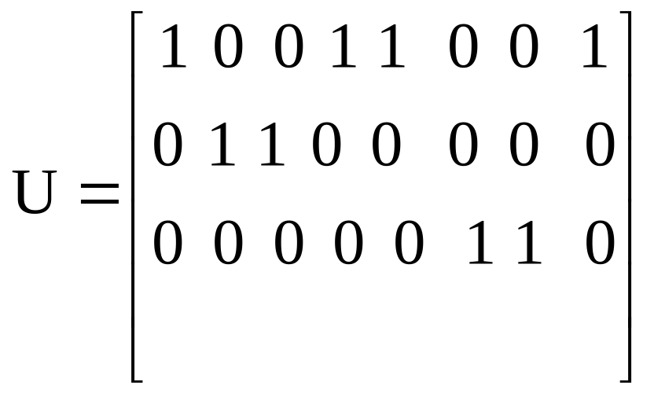
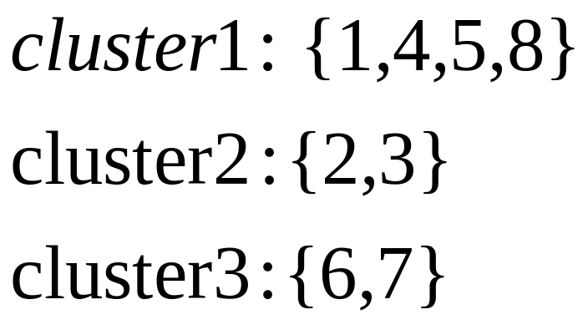
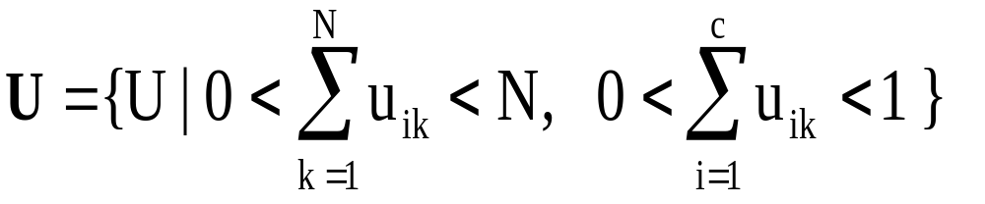
Partition Matrix
=
© 2007 Cios / Pedrycz / Swiniarski / Kurgan

Slide 40
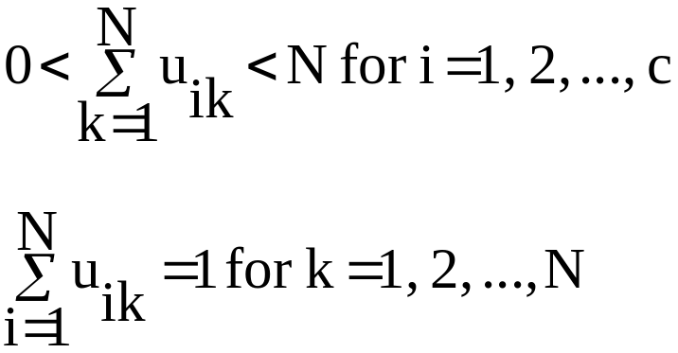
Partition / Objective Function Clustering
Clustering is guided by the minimization of the objective function Q.
Representation of structure is in the form of:
Partition matrix U = [u_{ik}], i=1,2,…,c; k=1, 2,…,N
Prototypes v_{i}, i=1,2,…, c
© 2007 Cios / Pedrycz / Swiniarski / Kurgan

Slide 41
Partition / Objective Function Clustering
Given: the guessed! number of clusters (c), and the chosen similarity function
(and value of the power factor (m) but only for fuzzy clustering)
Compute the prototypes (v) and update the
partition matrix (U) based on the conditions of the minimized objective function
Result: partition matrix and prototypes
© 2007 Cios / Pedrycz / Swiniarski / Kurgan

Slide 42
K-Means
Proposed about 60 years ago independently by few researchers:
  Steinhaus, H., 1956. Sur la division des corp materiels en parties. Bull. Acad. Polon. Sci. IV (C1.III), 801–804
  Lloyd, S., 1982. Least squares quantization in PCM. IEEE Trans. Inform. Theory 28,129–137. Originally as an unpublished Bell laboratories Technical Note (1957)
  Ball, G., Hall, D., 1965. ISODATA, a novel method of data anlysis and pattern classiﬁcation. Technical report NTIS AD 699616. Stanford Research Institute, Stanford, CA
  MacQueen, J., 1967. Some methods for classiﬁcation and analysis of multivariate observations. In: Fifth Berkeley Symposium on Mathematics. Statistics and Probability. University of California Press, pp. 281–297
© 2007 Cios / Pedrycz / Swiniarski / Kurgan

Slide 43
K-Means
The simplest and most frequently used clustering algorithm because of
  ease of implementation and efficiency.
Input
c = number of clusters
d = distance function
m = power (fuzziness) factor
  not used in hard K- means
t = termination criteria
  Amount of movement between clusters
v = cluster centers
  Randomly chosen for each run
Output
  U = partition matrix
  V = Cluster centers
© 2007 Cios / Pedrycz / Swiniarski / Kurgan

Slide 44
K-Means
    Given: the number of clusters k and dataset X with n points
      select initial k means as the first k points of data (or they can be user-provided or chosen randomly)
      calculate distances between all the points and the k-means
      allocate the point(s) to the cluster(s) whose mean is nearest to it
      recalculate the means of the k-clusters
      repeat 2-4 until a termination criterion is satisfied
      Result: A vector of size k of means (prototypes) of clusters; Partition Matrix P of size kxn
© 2007 Cios / Pedrycz / Swiniarski / Kurgan

Slide 45
K-Means
  Termination criteria
  When the summed difference of the old and new partitions (partition matrices) is less than a threshold
    Hard
      U_{new} - U_{old} == 0;
    Fuzzy
      U_{new} - U_{old} < user chosen number (like 0.0001)
© 2007 Cios / Pedrycz / Swiniarski / Kurgan

Slide 46
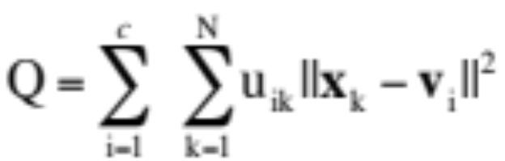
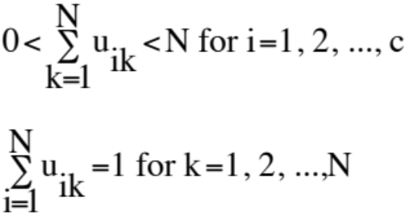
K-Means
Objective function
Minimize Q:
Sum of Errors Squared of N samples over c clusters subject to
u_{ik} = 0 or 1 (membership value = Sample k belongs
to cluster i or not)
© 2007 Cios / Pedrycz / Swiniarski / Kurgan

Slide 47
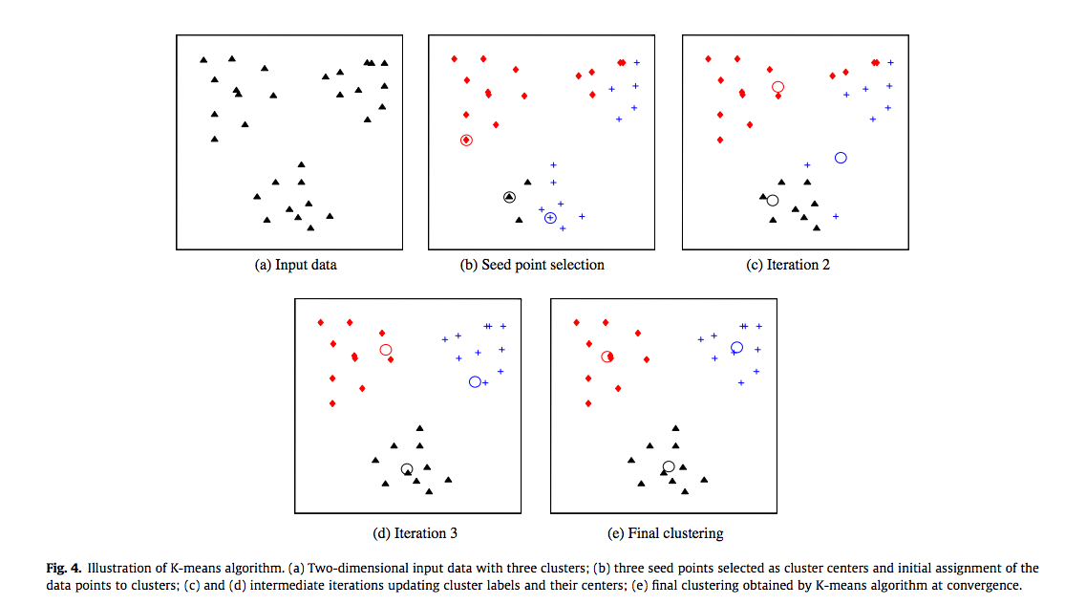
K-Means: Example
  Anil Jain. Data Clustering: 50 years beyond K-means; (http://biometrics.cse.msu.edu/Publications/Clustering/JainClustering_PRL10.pdf)

Slide 48
K-Means
Strength:
Relatively efficient: O(tkn), where n is # objects, k is # clusters, and t is # iterations. Normally, k, t << n.
    By comparison: PAM: O(k(n-k)² ), CLARA: O(ks² + k(n-k))
Weaknes:
Finds only local optimum.
The global optimum may be found using deterministic annealing or genetic algorithms.
Applicable only to numeric data (so that a mean can be calculated).
  User needs to specify k - the number of clusters
  Unable to handle noisy data and/or outliers
  Cannot discover clusters with non-convex shapes
from: Data Mining: Concepts and Techniques

Slide 49
K-Means: Selecting K
K-means is NP-hard problem and as a greedy algorithm converges to a local minimum
To minimize the local minima problem, run the algorithm with different starting points for a given K and pick the result with the smallest squared error
Different starting values of K lead to different clustering results:
  Run the K-means clustering algorithm with different values of K and pick the result that is the most meaningful to the domain expert (!)
  Perform silhouette analysis

Slide 50
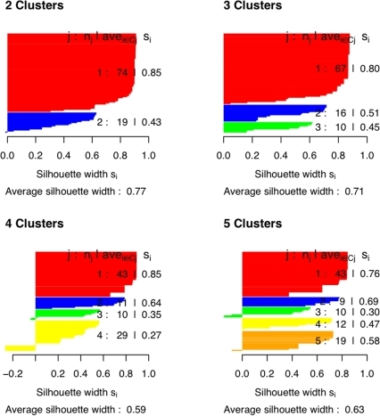
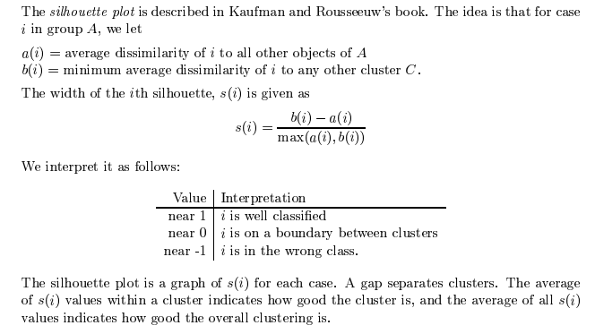
Silhouette Plot Analysis
http://www.plosone.org/article/info:doi/10.1371/journal.pone.0006937

Slide 51
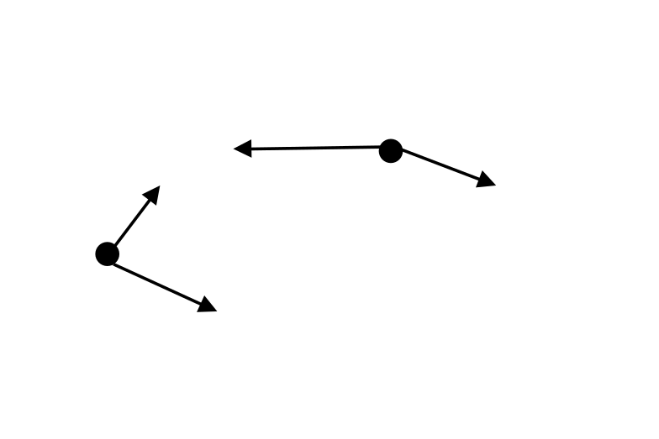
Fuzzy C-Means
How to deal (quantify) data that are in-between clusters?
Consider partial membership to clusters – > idea of fuzzy sets
elements with partial membership
© 2007 Cios / Pedrycz / Swiniarski / Kurgan

Slide 52
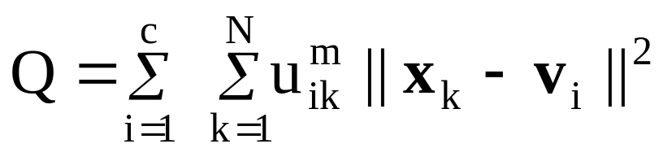
Fuzzy C-Means
Allows for partial membership in clusters –> fuzzy partition matrix U
Objective function
U = [u_{ik}]; u_{ik} – degree of membership of k-th data to i-th cluster
m – fuzzification coefficient, m>1
||. || - distance function
© 2007 Cios / Pedrycz / Swiniarski / Kurgan

Slide 53
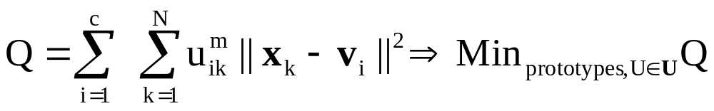
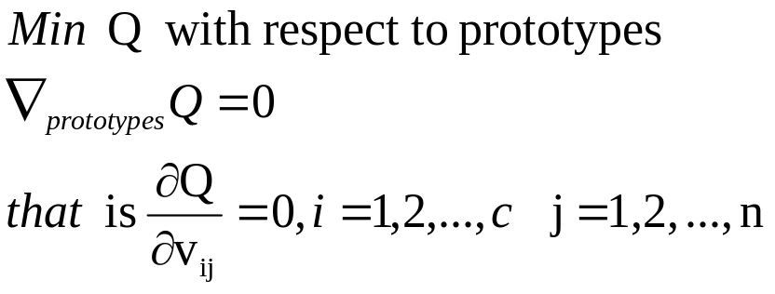
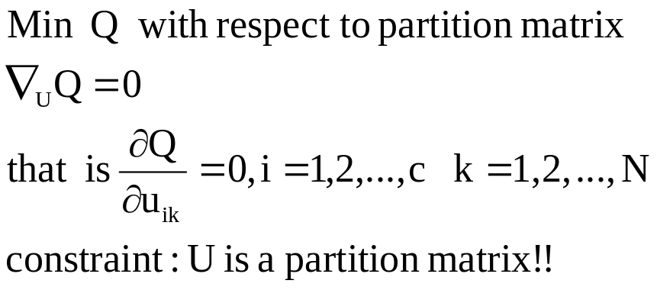
Fuzzy C-Means: Optimization
© 2007 Cios / Pedrycz / Swiniarski / Kurgan

Slide 54
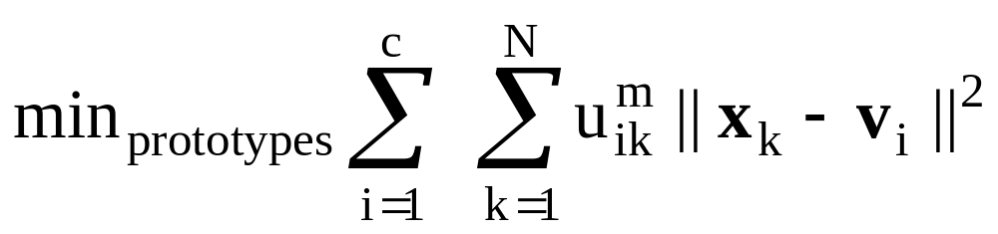
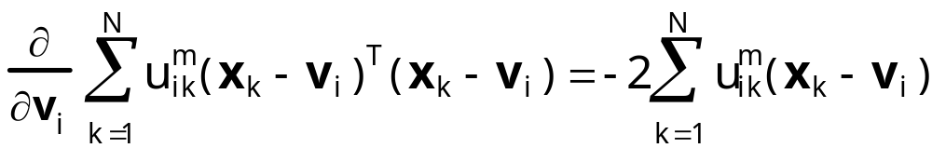


Fuzzy C-Means: Optimization
© 2007 Cios / Pedrycz / Swiniarski / Kurgan

Slide 55

Fuzzy C-Means
© 2007 Cios / Pedrycz / Swiniarski / Kurgan

Slide 56
Fuzzy C-Means
Design aspects
stopping criterion -> termination of iterations
fuzzification coefficient (m) : m>1
Shape of the membership functions
m =2.0 – typical value
m close to 1 – set like shape of membership functions
m higher than 2.0 - spike like membership functions
© 2007 Cios / Pedrycz / Swiniarski / Kurgan

Slide 57

Kernel-Based Clustering
Idea:
The original data points in the n-dimensional space
are transformed, through some mapping φ,
into elements in m-dimensional space, where m > n
Objective function in the new space:
© 2007 Cios / Pedrycz / Swiniarski / Kurgan

Slide 58
Kernel K-Means
K-Means cannot separate clusters that are linearly not separable
Kernel K-Means algorithm solves this shortcoming:
Before clustering, all points are mapped into a higher-dimensional space using some nonlinear function; then the algorithm partitions (clusters) points in the new space.
Major difference is calculation of distance in the kernel K-means algorithm by the kernel method and not, for instance, by simple Euclidean.
© 2007 Cios / Pedrycz / Swiniarski / Kurgan

Slide 59

from: Kernel Clustering, CSE 902, by Radha Chitta
© 2007 Cios / Pedrycz / Swiniarski / Kurgan

Slide 60
Kernel-Based Clustering
Given the dimensionality of a new space, m > n, we calculate in the new space a kernel function K(x,v) as a dot product
K(x,v) = φ^{T}(x)φ(v)
Gaussian kernel
K(x,v) = exp(- ||x-v||²/σ²)
© 2007 Cios / Pedrycz / Swiniarski / Kurgan

Slide 61

from: A Survey of Kernel ClusteringMethods by Filippone, Camastra, Masulli and Rovetta, Presented by: Grama
© 2007 Cios / Pedrycz / Swiniarski / Kurgan

Slide 62


Slide 63


Slide 64


Slide 65


Slide 66

© 2007 Cios / Pedrycz / Swiniarski / Kurgan

Slide 67

© 2007 Cios / Pedrycz / Swiniarski / Kurgan

Slide 68

K-Medoids Clustering
To increase robustness of clustering medoids are used instead of mean values. In one-dimensional case the medoid is the median.
Consider an ordered collection of data points
x₁ <= x₂ <= … <=x_{N}
Median is the central point in the sequence (for odd N) or an average of the two points in the middle (for even N).
outlier
© 2007 Cios / Pedrycz / Swiniarski / Kurgan

Slide 69


Median as a Robust Estimator
Median is a solution to the minimization problem:
Robustness is increased using this objective function
Advantage: one of the original points becomes cluster center
© 2007 Cios / Pedrycz / Swiniarski / Kurgan

Slide 70
K-Means vs. K-Medoids
K-Means is sensitive to outliers because a point with a large value substantially distorts distribution of the data.
K-Medoids: Instead of using the means we use the medoids - the most centrally located points in clusters.
10
10
9
9
8
8
7
7
6
6
5
5
4
4
3
3
2
2
1
1
0
0
0
1
2
3
4
5
6
7
8
9
10
0
1
2
3
4
5
6
7
8
9
10

Slide 71
K-Medoids
K-Medoids Clustering: Find representative objects (medoids) in clusters
  PAM (Partitioning Around Medoids)
    Start from an initial set of medoids and iteratively replace one of the medoids by one of the non-medoids - IF it improves the total distance of the resulting clustering
    PAM works well for small data sets but does not scale up due to its computational complexity: O(k(n-k)² ) for each iteration, where n # of data points, k # of clusters
Efficiency improvements on PAM
  CLARA (Clustering LARge Applications): PAM on sub-samples of data
  CLARANS: Randomized re-sampling

Slide 72
PAM
  1. Select k representative objects arbitrarily
  2. For each pair of a non-selected object h and the
  selected object i, calculate the total swapping cost TC_{ih}
  3. For each pair of i and h,
    If TC_{ih} < 0, i is replaced by h
    Then assign each non-selected object to the most similar representative object
  Repeat steps 2-3 until no change

Slide 73

PAM (K-Medoids) Algorithm
K=2
Total Cost = 20
10
9
8
Arbitrary choose k objects as initial medoids
Assign each remaining object to the nearest medoids
7
6
5
4
3
2
1
0
0
1
2
3
4
5
6
7
8
9
10
Randomly select a nonmedoid object,O_{ramdom}
Total Cost = 26
Do loop
Until no change
10
10
9
Compute total cost of swapping
9
Swap O and O_{ramdom}
if quality is improved.
8
8
7
7
6
6
5
5
4
4
3
3
2
2
1
1
0
0
1
2
3
4
5
6
7
8
9
10
0
0
1
2
3
4
5
6
7
8
9
10

Slide 74

PAM: Finding the Best Cluster Medoid
_{Four Cases}

Slide 75
PAM: Finding the Best Cluster Center
Case 1
Suppose p currently belongs to cluster represented by Oj and that
D(p,Oi) < D(p,Orandom)
If Oj is replaced by Orandom, p will belong to the cluster represented by Oi
swap cost: C=d(p,Oi) - d(p,Oj)
Case 2
P currently belongs to the cluster represented by Oj and this time assume that D(p,Oi) > D(p,Orandom)
If Oj is replaced by Orandom, p will belong to the cluster represented by Orandom
swap cost: C=d(p,Orandom)-d(p,Oj)

Slide 76
PAM: Finding the Best Cluster Center
Case 3
P currently belongs to a cluster represented by Oi instead of Oj and D(p,Oi) < D(p,Orandom)
If Oj is replaced by Orandom, p will still belong to the cluster represented by Oi
swap cost: C=0
Case 4
P currently belongs to cluster represented by Oi but
D(p,Oi) > D(p,Orandom)
If we replace Oj with Orandom, p will belong to Orandom
swap cost: C=d(p,Orandom)-d(p,Oi)

Slide 77
CLARA
CLARA (Kaufmann and Rousseeuw, 1990)
  It draws multiple samples of the data set, applies PAM on each sample, and gives the best clustering as the output
Strength: can deals with larger data sets
Weakness:
  Efficiency depends on the sample size
  A good clustering based on samples will not necessarily represent a good clustering of the whole data set if the sample is biased

Slide 78
CLARA
Five examples of size 40 (small number) +2K
For i =1 to 5, repeat the following steps:
2. Draw a sample of 40 + 2K objects randomly from the entire data set, and call PAM to find K-medoids of the sample.
3. For each object Oj in the entire data set, determine which of the K-medoids is the most similar to Oj.
4. Calculate the average dissimilarity of the clustering obtained in the previous step. If this value is less than the current minimum, use this value as the current minimum, and retain the K-medoids found in Step 2 as the best set of medoids obtained so far.
5. Return to Step 1 to start the next iteration

Slide 79

Model-Based Clustering
Mixture of data as an underlying model
Each component is described by some conditional probability density function described by parameters
Parameters estimation of the mixture of data
Maximum likelihood estimation
Given data points, x₁, x₂, …, x_{N} , choose parameters such that the value of the expression
becomes maximized
© 2007 Cios / Pedrycz / Swiniarski / Kurgan

Slide 80


Grid-Based Clustering
Describes structure in data in terms of generic geometric constructs – hyperboxes and their combinations
Formation of clusters by merging adjacent hyperboxes
Clusters of different geometry
© 2007 Cios / Pedrycz / Swiniarski / Kurgan

Slide 81

Grid-Based Clustering
Hyperboxes
© 2007 Cios / Pedrycz / Swiniarski / Kurgan

Slide 82

Grid-Based Clustering: Steps
© 2007 Cios / Pedrycz / Swiniarski / Kurgan

Slide 83
Grid-Based Clustering
Clustering highly-dimensional data
    Clusters may exist only in some subspaces
Methods
  Subspace-clustering: find clusters in all possible subspaces
    Example: CLIQUE

Slide 84
CLIQUE
CLIQUE can be considered as both density-based and grid-based
  It partitions each dimension into the same number of equal length intervals / rectangular units
  A unit is dense if the fraction of total data points contained in the unit exceeds the user-specified input parameter
  A cluster is formed as a maximal set of connected dense units within a subspace
Uses the monotonicity property: If a collection of points S forms a cluster in a K-dimensional space, then S is also part of a cluster in any (K-1) dimensional projections of this space.
Pruning is used to eliminate outliers that are not dense enough. This threshold is called the “optimal cut point”
From: Data Mining: Concepts and Techniques

Slide 85
Salary (10,000)
Vacation(week)
7
7
6
6
5
5
4
4
3
3
2
2
1
1
0
age
0
age
20
30
40
50
60
20
30
40
50
60
Vacation
Salary
30
50
age
From: Data Mining: Concepts and Techniques

Slide 86
References
Data Mining Concepts and Techniques, edited by Jiawei Han
http://home.deib.polimi.it/matteucc/Clustering/tutorial_html/AppletFCM.html
Yaling Pei, http://webdocs.cs.ualberta.ca/~yaling/Cluster/Applet/Code/Cluster.html
http://www.cs.uiuc.edu/~yyz/teaching/InfoVis-s10/gps-clustering.pdf
Yizhou Yu, www.cs.ndsu.nodak.edu/~adenton/datamining/DENCLUE.PPT‎
Li Cheng, webdocs.cs.ualberta.ca/~zaiane/courses/cmput695-00/.../LiClique.pdf‎

